Slide 1
Cat dataset
With over 9000 pictures with cats

Slide 2
The history of the dataset
Dataset was originally published in a paper named «Cat Head Detection - How to Effectively Exploit Shape and Texture Features» by Chinese scientists Weiwei Zhang, Jian Sun, and Xiaoou Tang in 2008.
At the same time around 2008, the dataset was uploaded on the site archive.org: https://archive.org/details/CAT_DATASET
In 2018 the dataset was uploaded on Kaggle by Chris Crawford and NAIN

Slide 3
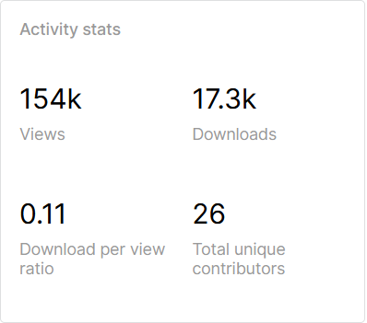
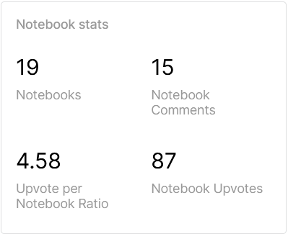
Activity information

Slide 4
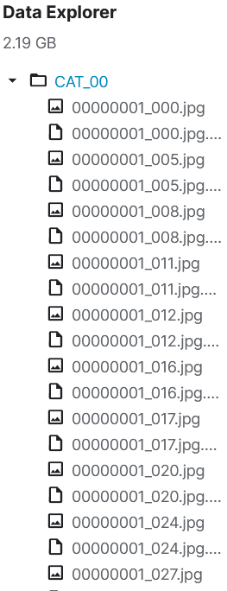
Context
The CAT dataset includes over 9,000 cat images. For each image, there are annotations of the head of cat with nine points, two for eyes, one for mouth, and six for ears.

Slide 5
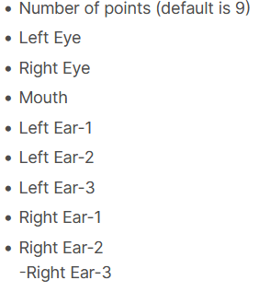
Content
The annotation data are stored in a file with the name of the corresponding image plus ."cat" at the end. There is one annotation file for each cat image. For each annotation file, the annotation data are stored in the following sequence:

Slide 6
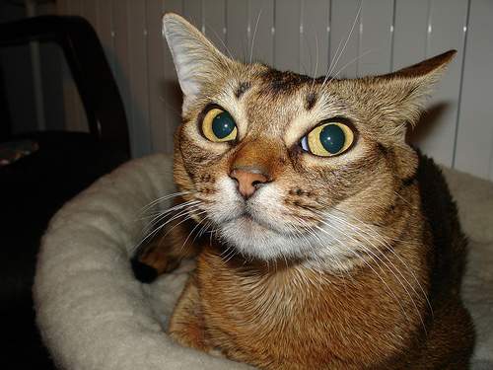
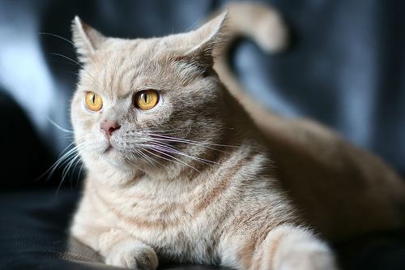
Dataset image examples

Slide 7
Dataset annotation data sequences
Coordinates of different parts of cats’ bodies
9 175 160 239 162 199 199 149 121 137 78 166 93 281 101 312 96 296 133
9 96 96 153 127 103 146 48 20 78 -37 127 5 210 52 260 63 229 121

Slide 8
What the point of the dataset?
The main idea behind this dataset is to train a neural network to identify images of cats.
The second important task is to make the neural network differs and identify different parts of cats faces.

